Slide 1
Desktop Assistant
(ANNY)
Yashvi Soni (18BECE30562)
Ashna Shah (18BECE30506)
Nidhi Patel (18BECE30109) Nikita Solanki (18BECE30111)
Guide: Prof. Manoj Sahu

Slide 2
“
It’s not much complicated and can be easily achieved using Python.
Personal digital assistants are capturing a lot of attention lately.
Chatbots are common in most commercial websites. With growing advancements in artificial intelligence, training the machines to tackle day-to-day tasks is the norm.
How cool is it to build our own personal assistants like Alexa or Siri ?

Slide 3
Voice based personal assistants have gained a lot of popularity in this era of smart homes and smart devices.
Desktop assistants can be easily configured to perform many of your regular tasks by simply giving them any voice commands.
Google has popularized voice-based search that is a boon for many like senior citizens who are not comfortable to use the keyboard or touchpad.

Slide 4
INTRODUCTION
A voice assistant is a digital assistant that uses voice recognition, language processing algorithms, and voice synthesis to listen to specific voice commands and return relevant information or perform specific functions as requested by the user.
Based on specific commands spoken by the user, voice assistants can return relevant information by listening for specific keywords and filtering out the noise.

Slide 5
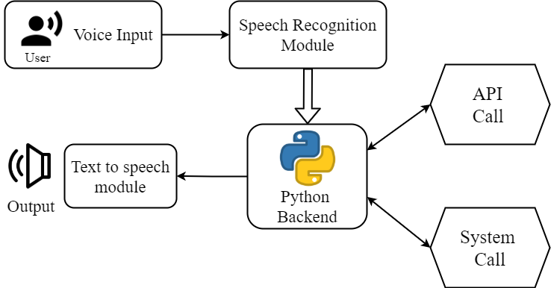
ARCHITECTURE
………..
………..
………..
………..

Slide 6
FEATURES

Slide 7
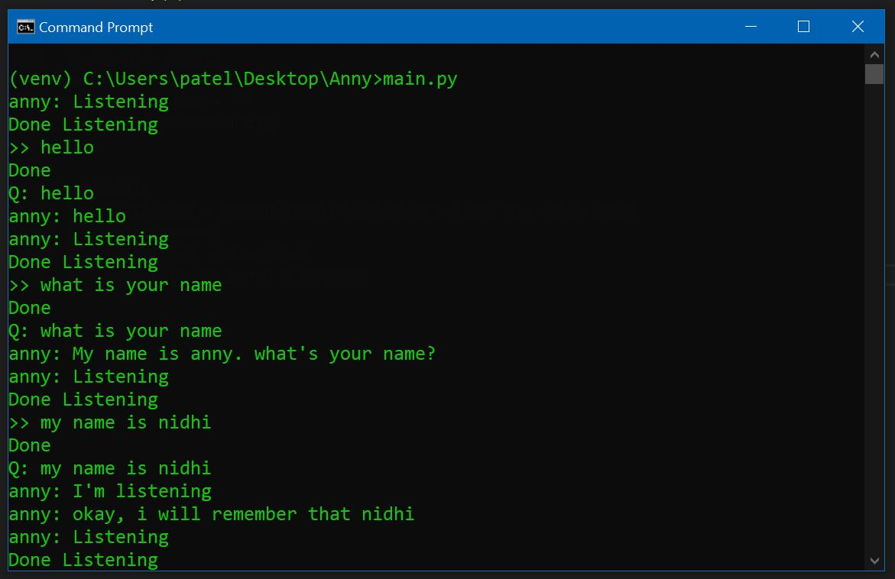
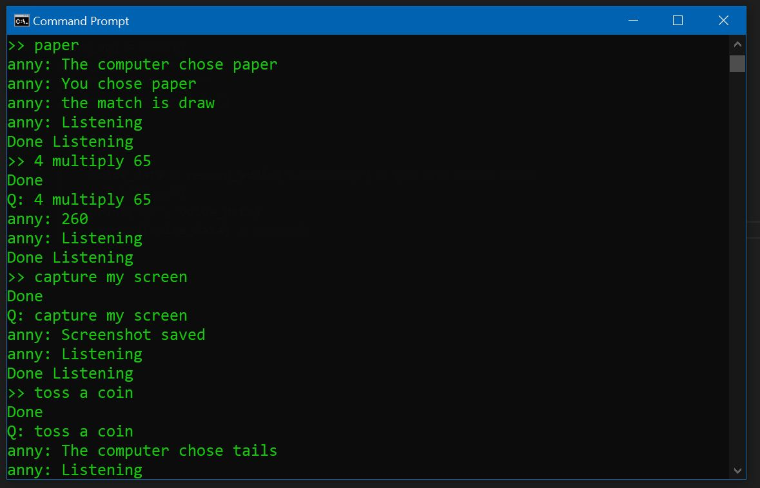
IMPLEMENTATION

Slide 8
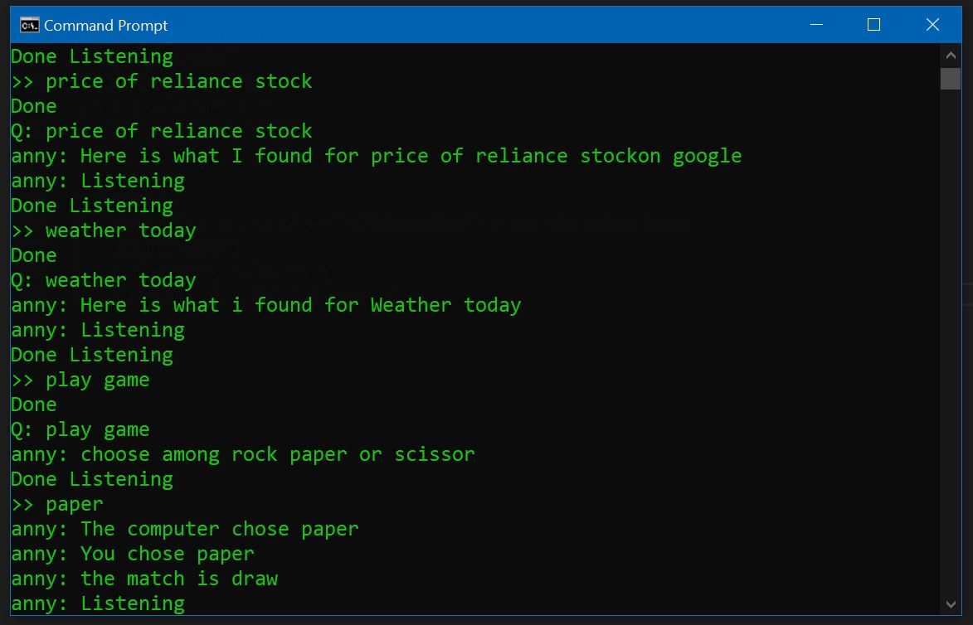
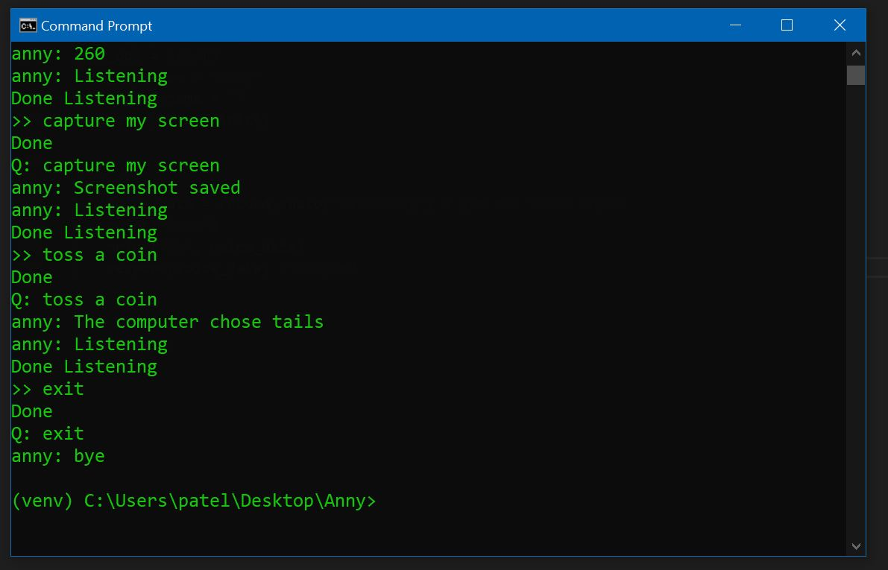
IMPLEMENTATION

Slide 9
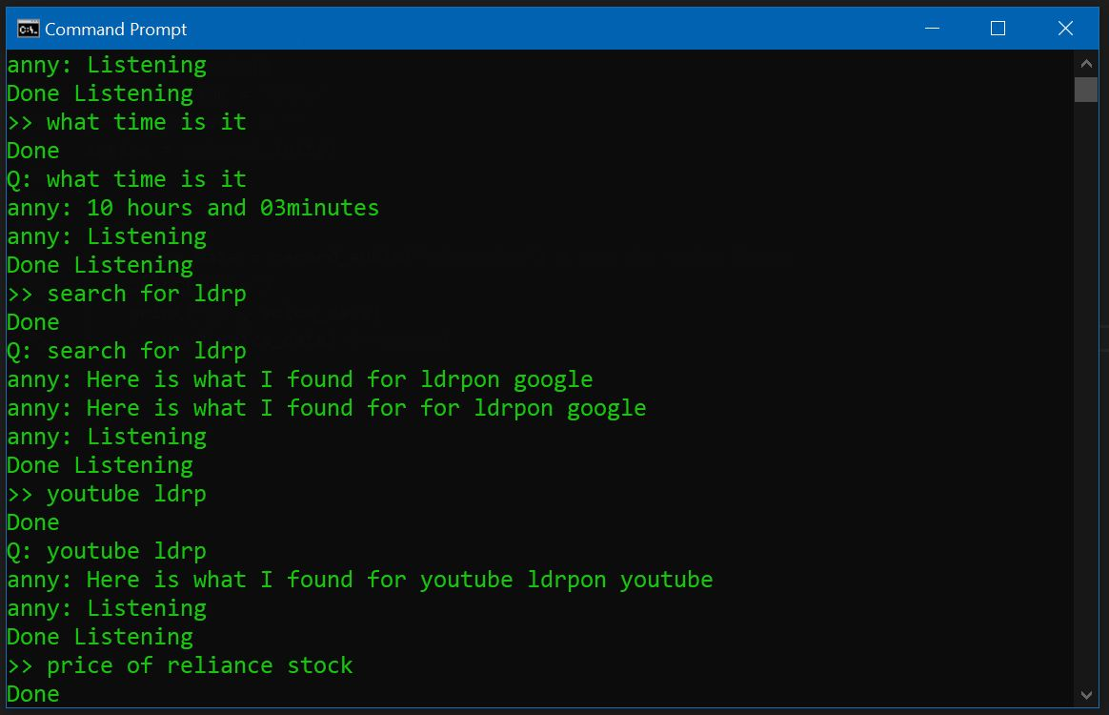
IMPLEMENTATION

Slide 10
CONCLUSION
The personal voice assistant system presented is very fundamental system with few features.
However the additional and advance feature may be introduced as future work of this project, the design and implementation of a Intelligent Personal Voice Assistance is described.
The projects built using available open source software modules with visual studio code community backing which can accommodate any updates in future.
The modular approach used in this project makes it more flexible and easy to integrate additional modules and features without disturbing the current system functionaries.
It not only works on human commands but also it is designed for give responses to the user on the basis of query being asked or the words spoken by the user such as opening tasks and operations.

Slide 11


LDRP Institute of Technology and Research, Gandhinagar.

